Slide 1



Noida Institute of Engineering and Technology, Greater Noida
Propositional & Predicate Logic
Unit: 4
Discrete Structures & Theory of Logic (KCS-303)
Mr. Gaurav Singhania
Asst. Prof., IT Dept.
Mr. Bhupendra Kr.
Asst. Prof., IT Dept.
Course Details
(Ex: B Tech 3rd Sem)
Mr. Gaurav Singhania, Mr. Bhupendra Kr. KCS-303 (DSTL) Unit 4

Slide 2
Course Objective
A course discrete structures used to represent discrete objects and relationships between these objects. These discrete structures include sets, relation , permutations, relations, graphs and trees etc.
The subject enhances one’s ability to develop logical thinking and ability to problem solving.
Mr. Gaurav Singhania, Mr. Bhupendra Kr. KCS-303 (DSTL) Unit 4

Slide 3
Unit 4 Objectives
Objective of proposition logic to write English sentences for logical expressions and vice-versa. Use standard notations of propositional logic.
Determine if a logical argument is valid or invalid. Apply standard rules of inference including (but not limited to) Modus Ponens, Modus Tollens, Transitivity, and Elimination. Recognize fallacies such as the Converse Error and the Inverse Error.
Translate between English sentences and symbols for universally and existentially quantified statements, including statements with multiple quantifiers.
Mr. Gaurav Singhania, Mr. Bhupendra Kr. KCS-303 (DSTL) Unit 4

Slide 4
Course Outcome
Course Outcome ( CO) | At the end of course , the student will be able to understand | Bloom’s Knowledge Level (KL)
CO1 | Write an argument using logical notation and determine if the argument is or is not valid. | K3, K4
CO2 | Understand the basic principles of sets and operations in sets. | K1, K2
CO3 | Demonstrate an understanding of relations and functions and be able to determine their properties | K3
CO4 | Demonstrate different traversal methods for trees and graphs. | K1, K4
CO5 | Model problems in Computer Science using graphs and trees. | K2, K6
Mr. Gaurav Singhania, Mr. Bhupendra Kr. KCS-303 (DSTL) Unit 4

Slide 5
CO-PO’s and PSO’s Mapping
 | PO1 | PO2 | PO3 | PO4 | PO5 | PO6 | PO7 | PO8 | PO9 | PO10 | PO11 | PO12
KCS303.1 | 3 | 2 | 2 | - | - | 1 | - | - | - | 1 | 1 | 3
KCS303.2 | 3 | 3 | 2 | 2 | 1 | - | - | - | - | - | 2 | 1
KCS303.3 | 3 | 3 | 2 | 1 | - | - | 3 | - | 2 | 2 | 2 | 2
KCS303.4 | 3 | 3 | 2 | 1 | - | - | 1 | - | - | 3 | 2 | 2
KCS303.5 | 3 | 3 | 2 | 1 | - | - | 3 | - | - | 1 | 3 | 3
 | PSO1 | PSO2 | PSO3 | PSO4
KCS303.1 | 1 | 2 | 3 | -
KCS303.2 | 1 | 2 | 3 | 1
KCS303.3 | 3 | 2 | 3 | 1
KCS303.4 | 2 | 3 | 3 | -
KCS303.5 | 2 | 3 | 2
Mr. Gaurav Singhania, Mr. Bhupendra Kr. KCS-303 (DSTL) Unit 4

Slide 6
Prerequisite & Recap (CO4)
Prerequisite
Basic Understanding of class 10 mathematics NCERT.
Basic Knowledge of sets and algebraic rules
Basic Understanding of Set Theory, Relations and Functions .
Basic Understanding of Algebraic Structures.
Recap
Now students are able to develop there logical thinking by using Sets, Relations, Functions and Mathematical Induction, & Algebraic Structures concepts and use in upcoming topic. i.e. Lattices & Boolean Algebra.
Mr. Gaurav Singhania, Mr. Bhupendra Kr. KCS-303 (DSTL) Unit 4

Slide 7
Content (CO4)
Propositions
Negation
Conjunction
Disjunction
Exclusive or
Implication
Biconditional
Mr. Gaurav Singhania, Mr. Bhupendra Kr. KCS-303 (DSTL) Unit 4

Slide 8
Topic Objectives: Propositions(CO4)
The student will demonstrate the ability to use mathematical logic to solve problems
The student will be able to:
  represent English-language statements using symbolic logic notation.
  use and interpret relational conjunctions (and, or, xor, not), terms of causation (if… then) and equivalence (if and only if).
  use truth tables to analyze the truth values of compound statements based on the truth values of their components.
  use truth tables to determine if two statements are logically equivalent.
  use truth tables to identify tautologies and contradictions.
Mr. Gaurav Singhania, Mr. Bhupendra Kr. KCS-303 (DSTL) Unit 4
DSGT <number>

Slide 9
Topic Prerequisite & Recap (CO4)
Prerequisite
Basic Understanding of class 10 mathematics NCERT.
Basic Knowledge of sets and algebraic rules
Basic Understanding of Set Theory, Relations and Functions & Algebraic Structures.
Basic Understanding of Lattices & Boolean Algebra
Recap
Now students are able to develop there logical thinking by using Sets, Relations, Functions and Mathematical Induction, Algebraic Structures, Lattices & Boolean Algebra concepts and use in upcoming topic. i.e. Propositions.
Mr. Gaurav Singhania, Mr. Bhupendra Kr. KCS-303 (DSTL) Unit 4

Slide 10
Propositions(CO4)
A proposition is a statement that is either true or false (not both).
We say that the truth value of a proposition is either true (T or 1) or false (F or 0).
Example Beijing is the capital of China T
2 + 2 = 5 F
1 + 2 = 3 T
Mr. Gaurav Singhania, Mr. Bhupendra Kr. KCS-303 (DSTL) Unit 4

Slide 11
Examples of Non-Propositions(CO4)
The following are NOT propositions
Example
Who’s there?
Just do it!
La la la la la
1 + 2
x + 2 = 5
Mr. Gaurav Singhania, Mr. Bhupendra Kr. KCS-303 (DSTL) Unit 4

Slide 12
Propositions(CO4)
The Statement/Proposition example
“Elephants are bigger than mice.”
Is this a statement? Yes
Is this a proposition? Yes
What is the truth value True
of the proposition?
Mr. Gaurav Singhania, Mr. Bhupendra Kr. KCS-303 (DSTL) Unit 4

Slide 13
Propositions(CO4)
The Statement/Proposition example
“520 < 111”
Is this a statement? Yes
Is this a proposition? Yes
What is the truth value False
of the proposition?
Mr. Gaurav Singhania, Mr. Bhupendra Kr. KCS-303 (DSTL) Unit 4

Slide 14
Propositions(CO4)
The Statement/Proposition example
“y > 5”
Is this a statement? Yes
Is this a proposition? No
Its truth value depends on the value of y, but this value is not Specified. We call this type of statement a propositional function or open sentence
Mr. Gaurav Singhania, Mr. Bhupendra Kr. KCS-303 (DSTL) Unit 4

Slide 15
Combining Propositions(CO4)
As we have seen in the previous examples, one or more propositions can be combined to form a single compound proposition.
We formalize this by denoting propositions with letters such as p, q, r, s, and introducing several logical operators.
Mr. Gaurav Singhania, Mr. Bhupendra Kr. KCS-303 (DSTL) Unit 4

Slide 16
Logical Operators (Connectives) (CO4)
We will examine the following logical operators
Negation (NOT)
Conjunction (AND)
Disjunction (OR)
Exclusive or (XOR)
Implication (if – then)
Biconditional (if and only if)
Truth tables can be used to show how these operators can combine propositions to compound propositions.
Mr. Gaurav Singhania, Mr. Bhupendra Kr. KCS-303 (DSTL) Unit 4

Slide 17
Negation (NOT) (CO4)
It is Unary Operator and denoted by Symbol: ¬
P | ¬P
true (T) | false (F)
false (F) | true (T)
Mr. Gaurav Singhania, Mr. Bhupendra Kr. KCS-303 (DSTL) Unit 4

Slide 18
Conjunction (AND) (CO4)
It is binary Operator and Symbol is ∧
P | Q | P∧Q
T | T | T
T | F | F
F | T | F
F | F | F
Mr. Gaurav Singhania, Mr. Bhupendra Kr. KCS-303 (DSTL) Unit 4

Slide 19
Disjunction (OR) (CO4)
It is binary Operator and Symbol is ∨
P | Q | P∨Q
T | T | T
T | F | T
F | T | T
F | F | F
Mr. Gaurav Singhania, Mr. Bhupendra Kr. KCS-303 (DSTL) Unit 4

Slide 20
Exclusive Or (XOR) (CO4)
It is binary Operator and Symbol is ⊕
P | Q | P⊕Q
T | T | F
T | F | T
F | T | T
F | F | F
Mr. Gaurav Singhania, Mr. Bhupendra Kr. KCS-303 (DSTL) Unit 4

Slide 21
Implication (if - then) (CO4)
It is binary Operator and Symbol is →
P | Q | P→Q
T | T | T
T | F | F
F | T | T
F | F | T
Mr. Gaurav Singhania, Mr. Bhupendra Kr. KCS-303 (DSTL) Unit 4

Slide 22
Biconditional (if and only if) (CO4)
It is binary Operator and Symbol is ↔
P | Q | P↔Q
T | T | T
T | F | F
F | T | F
F | F | T
Mr. Gaurav Singhania, Mr. Bhupendra Kr. KCS-303 (DSTL) Unit 4

Slide 23
Statements and Operators(CO4)
Example 1 Statements and operators can be combined in any way to form new statements.
P | Q | ¬P | ¬Q | (¬P)∨(¬Q)
T | T | F | F | F
T | F | F | T | T
F | T | T | F | T
F | F | T | T | T
Mr. Gaurav Singhania, Mr. Bhupendra Kr. KCS-303 (DSTL) Unit 4

Slide 24
Statements and Operators(CO4)
Example 2 Statements and operators can be combined in any way to form new statements.
P | Q | P∧Q | ¬ (P∧Q) | (¬P)∨(¬Q)
T | T | T | F | F
T | F | F | T | T
F | T | F | T | T
F | F | F | T | T
Mr. Gaurav Singhania, Mr. Bhupendra Kr. KCS-303 (DSTL) Unit 4

Slide 25
Equivalent Statements(CO4)
The statements ¬(P∧Q) and (¬P) ∨ (¬Q) are logically equivalent, since ¬(P∧Q) ↔ (¬P) ∨ (¬Q) is always true.
P | Q | ¬(P∧Q) | (¬P)∨(¬Q) | ¬(P∧Q)↔(¬P)∨(¬Q)
T | T | F | F | T
T | F | T | T | T
F | T | T | T | T
F | F | T | T | T
Mr. Gaurav Singhania, Mr. Bhupendra Kr. KCS-303 (DSTL) Unit 4

Slide 26
Tautologies and Contradictions(CO4)
A tautology is a statement that is always true.
Examples: ¬(P∧Q)↔(¬P)∨(¬Q)
If S→T is a tautology, we write S⇒T.
If S↔T is a tautology, we write S⇔T.
P | Q | ¬(P∧Q) | (¬P)∨(¬Q) | ¬(P∧Q)↔(¬P)∨(¬Q)
T | T | F | F | T
T | F | T | T | T
F | T | T | T | T
F | F | T | T | T
Mr. Gaurav Singhania, Mr. Bhupendra Kr. KCS-303 (DSTL) Unit 4

Slide 27
Tautologies and Contradictions(CO4)
A contradiction is a statement that is always False
Examples: R∧(¬R) ¬(¬(P∧Q)↔(¬P)∨(¬Q))
The negation of any tautology is a contradiction, and the negation of any contradiction is a tautology.
Mr. Gaurav Singhania, Mr. Bhupendra Kr. KCS-303 (DSTL) Unit 4

Slide 28
Topic Objectives: Propositional Functions(CO4)
The student will demonstrate the ability to use mathematical logic to solve problems
The student will be able to:
  represent English-language statements using symbolic logic notation.
  use and interpret relational conjunctions (and, or, xor, not), terms of causation (if… then) and equivalence (if and only if).
  use truth tables to analyze the truth values of compound statements based on the truth values of their components.
  use truth tables to determine if two statements are logically equivalent.
  use truth tables to identify tautologies and contradictions.
Mr. Gaurav Singhania, Mr. Bhupendra Kr. KCS-303 (DSTL) Unit 4
DSGT <number>

Slide 29
Topic Prerequisite & Recap (CO4)
Prerequisite
Basic Understanding of class 10 mathematics NCERT.
Basic Knowledge of sets and algebraic rules
Basic Understanding of Sets, Relations, Functions and Mathematical Induction, Algebraic Structures, Lattices and Boolean Algebra, & Propositions.
Recap
Now students are able to develop there logical thinking by using Sets, Relations, Functions and Mathematical Induction, Algebraic Structures, Lattices and Boolean Algebra, & Propositions concepts and use in upcoming topic. i.e. Propositional Functions.
Mr. Gaurav Singhania, Mr. Bhupendra Kr. KCS-303 (DSTL) Unit 4

Slide 30
Propositional Functions(CO4)
Propositional function (open sentence): statement involving one or more variables, Example x-3 > 5.
Let us call this propositional function P(x), where P is the predicate and x is the variable.
What is the truth value of P(2) ? False
What is the truth value of P(8) ? False
What is the truth value of P(9) ? True
Mr. Gaurav Singhania, Mr. Bhupendra Kr. KCS-303 (DSTL) Unit 4

Slide 31
Propositional Functions(CO4)
Let us consider the propositional function Q(x, y, z) defined as x + y = z.
Here, Q is the predicate and x, y, and z are the variables.
What is the truth value of Q(2, 3, 5) ? True
What is the truth value of Q(0, 1, 2) ? False
What is the truth value of Q(9, -9, 0) ? True
Mr. Gaurav Singhania, Mr. Bhupendra Kr. KCS-303 (DSTL) Unit 4

Slide 32
Universal Quantification(CO4)
Let P(x) be a propositional function.
Universally quantified sentence: For all x in the universe of discourse P(x) is true.
Using the universal quantifier ∀: ∀x P(x) “for all x P(x)” or “for every x P(x)”
(Note: ∀x P(x) is either true or false, so it is a proposition, not a propositional function.)
Mr. Gaurav Singhania, Mr. Bhupendra Kr. KCS-303 (DSTL) Unit 4

Slide 33
Universal Quantification(CO4)
Example:
S(x): x is a UMBC student.
G(x): x is a genius.
What does ∀x (S(x) → G(x)) mean ?
“If x is a UMBC student, then x is a genius.”
or
“All UMBC students are geniuses.”
Mr. Gaurav Singhania, Mr. Bhupendra Kr. KCS-303 (DSTL) Unit 4

Slide 34
Existential Quantification(CO4)
Existentially quantified sentence:There exists an x in the universe of discourse for which P(x) is true.
Using the existential quantifier ∃:
∃x P(x) “There is an x such that P(x).”
“There is at least one x such that P(x).”
(Note: ∃x P(x) is either true or false, so it is a proposition, but no propositional function.)
Mr. Gaurav Singhania, Mr. Bhupendra Kr. KCS-303 (DSTL) Unit 4

Slide 35
Quantification(CO4)
Another example: Let the universe of discourse be the real numbers.
What does ∀x∃y (x + y = 320) mean ?
“For every x there exists a y so that x + y = 320.”
Is it true? Yes
Is it true for the natural numbers? No
Mr. Gaurav Singhania, Mr. Bhupendra Kr. KCS-303 (DSTL) Unit 4
30

Slide 36
Faculty Video Links, Youtube & NPTEL Video Links and Online Courses Details(CO4)
Youtube/other Video Links
https://www.youtube.com/watch?v=Ib5njCwNMdk&list=PLBlnK6fEyqRhqJPDXcvYlLfXPh37L89g3&index=3
https://www.youtube.com/watch?v=6kYngPvoGxU&list=PLBlnK6fEyqRhqJPDXcvYlLfXPh37L89g3&index=4
https://www.youtube.com/watch?v=m2mf6I3g2-c&list=PLBlnK6fEyqRhqJPDXcvYlLfXPh37L89g3&index=5
https://www.youtube.com/watch?v=tACXuzfXzSI&list=PLBlnK6fEyqRhqJPDXcvYlLfXPh37L89g3&index=6
https://www.youtube.com/watch?v=ccz-w2JMsTM&list=PLBlnK6fEyqRhqJPDXcvYlLfXPh37L89g3&index=7
Mr. Gaurav Singhania, Mr. Bhupendra Kr. KCS-303 (DSTL) Unit 4

Slide 37
Daily Quiz(CO4)
Q1 ¬ (p ↔ q) is logically equivalent to:
(a) p ↔ ¬q (b) ¬p ↔ q
(c)
Q2 Which of the following option is true?
(a) If the Sun is a planet, elephants will fly
(b) 3 +2 = 8 if 5-2 = 7
(c) 1 > 3 and 3 is a positive integer
(d) -2 > 3 or 3 is a negative integer
Q3 The truth value of given statement is
‘If 9 is prime then 3 is even’.
(a) False (b) True
Mr. Gaurav Singhania, Mr. Bhupendra Kr. KCS-303 (DSTL) Unit 4

Slide 38
Daily Quiz(CO4)
Q4 Let P: I am in Bangalore. , Q: I love cricket. ; then q -> p(q implies p) is:
(a) If I love cricket then I am in Bangalore
(b) If I am in Bangalore then I love cricket
(c) I am not in Bangalore
(d) I love cricket
Q5 Let P: We should be honest., Q: We should be dedicated .,R: We should be over confident.Then ‘We should be honest or dedicated but not overconfident.’ is best represented by:
(a) ~P V ~Q V R
(b) P ∧ ~Q ∧ R
(c) P V Q ∧ R
(d) P V Q ∧ ~R
Mr. Gaurav Singhania, Mr. Bhupendra Kr. KCS-303 (DSTL) Unit 4

Slide 39
Weekly Assignment(CO4)
Q1 What do you mean by logical equivalence? Explain with an example.
Q2 Construct the truth table of the following
~ (𝑃∨ (𝑄∧𝑅)) ⟺ ((𝑃∨𝑄) ∧ (𝑃∨𝑅 ))
Q3 Show that which of the following statements tautology are.
(i) (( 𝑃∨∽𝑄) ∧(∽𝑃∨∽𝑄))∨𝑄
(ii) (~𝑃∧𝑄 ⟹(𝑄⟹𝑃))
Q4 Using truth table prove that: P ↔ Q ≡ (P → Q) ∧ (Q → P).
Q5 Using logical equivalent formulas, show that
~ (P ∨ (~ P ∧ Q)) ≡ ~ P ∧ ~ Q.
Q6 Express (~𝑝→𝑟) ∧(𝑞⟷𝑞) in its principle conjunctive normal form
Q7 Define Minterms and Maxterms and find the principal disjunctive normal form of the following:- (𝑝∧𝑞) ∨ (~𝑝∧𝑟) ∨(𝑞∧𝑟)
Mr. Gaurav Singhania, Mr. Bhupendra Kr. KCS-303 (DSTL) Unit 4

Slide 40
MCQs(CO4)
Q1 Which of the following statement is a proposition?
(a) Get me a glass of milkshake
(b) God bless you!
(c) What is the time now?
(d) The only odd prime number is 2
Q2 Let P: I am in Delhi. , Q: Delhi is clean. ; then q ^ p(q and p) is:
(a) Delhi is clean and I am in Delhi
(b) Delhi is not clean or I am in Delhi
(c) I am in Delhi and Delhi is not clean
(d) Delhi is clean but I am in Mumbai
Q3 The compound propositions p and q are called logically equivalent if ________ is a tautology.
(a) p ↔ q (b) p → q (c) ¬ (p ∨ q) (d) ¬p ∨ ¬q
Mr. Gaurav Singhania, Mr. Bhupendra Kr. KCS-303 (DSTL) Unit 4

Slide 41
MCQs (CO4)
Q4 p → q is logically equivalent to:
(a) ¬p ∨ ¬q (b) p ∨ ¬q (c) ¬p ∨ q (d) ¬p ∧ q
Q5 p ∨ q is logically equivalent to:
(a) ¬q → ¬p (b) q → p (c) ¬p → ¬q (d) ¬p → q
Q6 Which of the following statement is correct?
(a) p ∨ q ≡ q ∨ p
(b) ¬(p ∧ q) ≡ ¬p ∨ ¬q
(c) (p ∨ q) ∨ r ≡ p ∨ (q ∨ r)
(d) All of mentioned
Q7 (p → q) ∧ (p → r) is logically equivalent to:
(a) p → (q ∧ r ) (b) p → (q ∨ r)
(c) p ∧ (q ∨ r) (d) p ∨ (q ∧ r)
Mr. Gaurav Singhania, Mr. Bhupendra Kr. KCS-303 (DSTL) Unit 4

Slide 42
MCQs (CO4)
Q4 p → q is logically equivalent to:
(a) ¬p ∨ ¬q (b) p ∨ ¬q (c) ¬p ∨ q (d) ¬p ∧ q
Q5 p ∨ q is logically equivalent to:
(a) ¬q → ¬p (b) q → p (c) ¬p → ¬q (d) ¬p → q
Q6 Which of the following statement is correct?
(a) p ∨ q ≡ q ∨ p
(b) ¬(p ∧ q) ≡ ¬p ∨ ¬q
(c) (p ∨ q) ∨ r ≡ p ∨ (q ∨ r)
(d) All of mentioned
Q7 (p → q) ∧ (p → r) is logically equivalent to:
(a) p → (q ∧ r ) (b) p → (q ∨ r)
(c) p ∧ (q ∨ r) (d) p ∨ (q ∧ r)
Mr. Gaurav Singhania, Mr. Bhupendra Kr. KCS-303 (DSTL) Unit 4

Slide 43
MCQs (CO4)
Q8 Which of the following statement is a proposition?
a) Get me a glass of milkshake
b) God bless you!
c) What is the time now?
d) The only odd prime number is 2
Q9 The truth value of given statement is
‘4+3=7 or 5 is not prime’.
a) False
b) True
Q10. Which of the following option is true?
a) If the Sun is a planet, elephants will fly
b) 3 +2 = 8 if 5-2 = 7
c) 1 > 3 and 3 is a positive integer
d) -2 > 3 or 3 is a negative intege
Mr. Gaurav Singhania, Mr. Bhupendra Kr. KCS-303 (DSTL) Unit 4

Slide 44
MCQs (CO4)
Q11 What is the value of x after this statement, assuming initial value of x is 5?‘If x equals to one then x=x+2 else x=0’.
a) 1 b) 3
c) 0 d) 2
Q12 Let P: I am in Bangalore. , Q: I love cricket. ; then q -> p(q implies p) is:
a) If I love cricket then I am in Bangalore
b) If I am in Bangalore then I love cricket
c) I am not in Bangalore
d) I love cricket
Q13. Let P:If Sahil bowls, Saurabh hits a century. ,Q: If Raju bowls , Sahil gets out on first ball. Now if P is true and Q is false then which of the following can be true?
a) Raju bowled and Sahil got out on first ball
b) Raju did not bowled
c) Sahil bowled and Saurabh hits a century
d) Sahil bowled and Saurabh got out
Mr. Gaurav Singhania, Mr. Bhupendra Kr. KCS-303 (DSTL) Unit 4

Slide 45
MCQs (CO4)
Q14 The truth value of given statement is
‘If 9 is prime then 3 is even’.
a) False
b) True
Q15 Let P: I am in Delhi. , Q: Delhi is clean. ; then q ^ p(q and p) is:
a) Delhi is clean and I am in Delhi
b) Delhi is not clean or I am in Delhi
c) I am in Delhi and Delhi is not clean
d) Delhi is clean but I am in Mumbai
Q16 Let P: This is a great website, Q: You should not come back here.
Then ‘This is a great website and you should come back here.’ is best represented by:
a) ~P V ~Q b) P ∧ ~Q
c) P V Q d) P ∧ Q
Mr. Gaurav Singhania, Mr. Bhupendra Kr. KCS-303 (DSTL) Unit 4

Slide 46
MCQs (CO4)
Q17. Let P: We should be honest., Q: We should be dedicated .,R: We should be overconfident.
Then ‘We should be honest or dedicated but not overconfident.’ is best represented by:
a) ~P V ~Q V R b) P ∧ ~Q ∧ R
c) P V Q ∧ R d) P V Q ∧ ~R
Q18. A compound proposition that is always ___________ is called a tautology.
a) True b) False
Q19 Let P (x) denote the statement “x >7.” Which of these have truth value true?
a) P (0) b) P (4)
c) P (6) d) P (9)
Mr. Gaurav Singhania, Mr. Bhupendra Kr. KCS-303 (DSTL) Unit 4

Slide 47
MCQs (CO4)
Q20. The statement,” Every comedian is funny” where C(x) is “x is a comedian” and F (x) is “x is funny” and the domain consists of all people.
a) ∃x(C(x) ∧ F (x))
b) ∀x(C(x) ∧ F (x))
c) ∃x(C(x) → F (x))
d) ∀x(C(x) → F (x))
Mr. Gaurav Singhania, Mr. Bhupendra Kr. KCS-303 (DSTL) Unit 4

Slide 48
A1(CO4)
1. Rewrite the following statements without using conditional:
(a) If it is cold, he wears a hat.
(b) If productivity increase, then wages rise.
2. Whenever Ram and Shyam are present in the party then there is some
trouble in the party. Today there is no trouble in the party. Hence Ram and
Shyam are not present in the party. Write it in symbolic notation
3. Let p be “Kailash reads Newsweek” , let “Kailash reads the New Yorker”
and let r be “Kailash reads Times”. Write each of following in symbolic
form:
(a) Kailash reads Newsweeks or The New Yorker, but not Times.
(b) Kailash reads Newsweeks and The New Yorker or he does not
read Newsweeks and Times.
(c) It is not true that Kailash reads Newsweek but not Times.
Mr. Gaurav Singhania, Mr. Bhupendra Kr. KCS-303 (DSTL) Unit 4

Slide 49
A1(CO4)
4. Write the contra positive of the implication: “if it is Sunday then it is a holiday
5. Show that the propositions 𝑝→𝑞𝑎𝑛𝑑 ¬𝑝∨𝑞 are logically equivalent.
7. Explain various Rules of Inference for Propositional Logic.
8. Prove the validity of the following argument “if the races are fixed so the casinos are crooked, then the tourist trade will decline. If the tourist trade decreases, then the police will be happy. The police force is never happy. Therefore, the races are not fixed.
9. What is a tautology, contradiction and contingency? Show that (p ∨ q) ∧ (¬ p ∨ r) → (q ∨ r) is a tautology, contradiction or contingency.
Mr. Gaurav Singhania, Mr. Bhupendra Kr. KCS-303 (DSTL) Unit 4

Slide 50
A1(CO4)
10.Show that the premises “It is not sunny this afternoon and it is colder than yesterday,” “We will go swimming only if it is sunny,” “If we do not go swimming, then we will take a canoe trip,” and “If we take a canoe trip, then we will be home by sunset” lead to the conclusion “We will be home by sunset.”
Mr. Gaurav Singhania, Mr. Bhupendra Kr. KCS-303 (DSTL) Unit 4

Slide 51
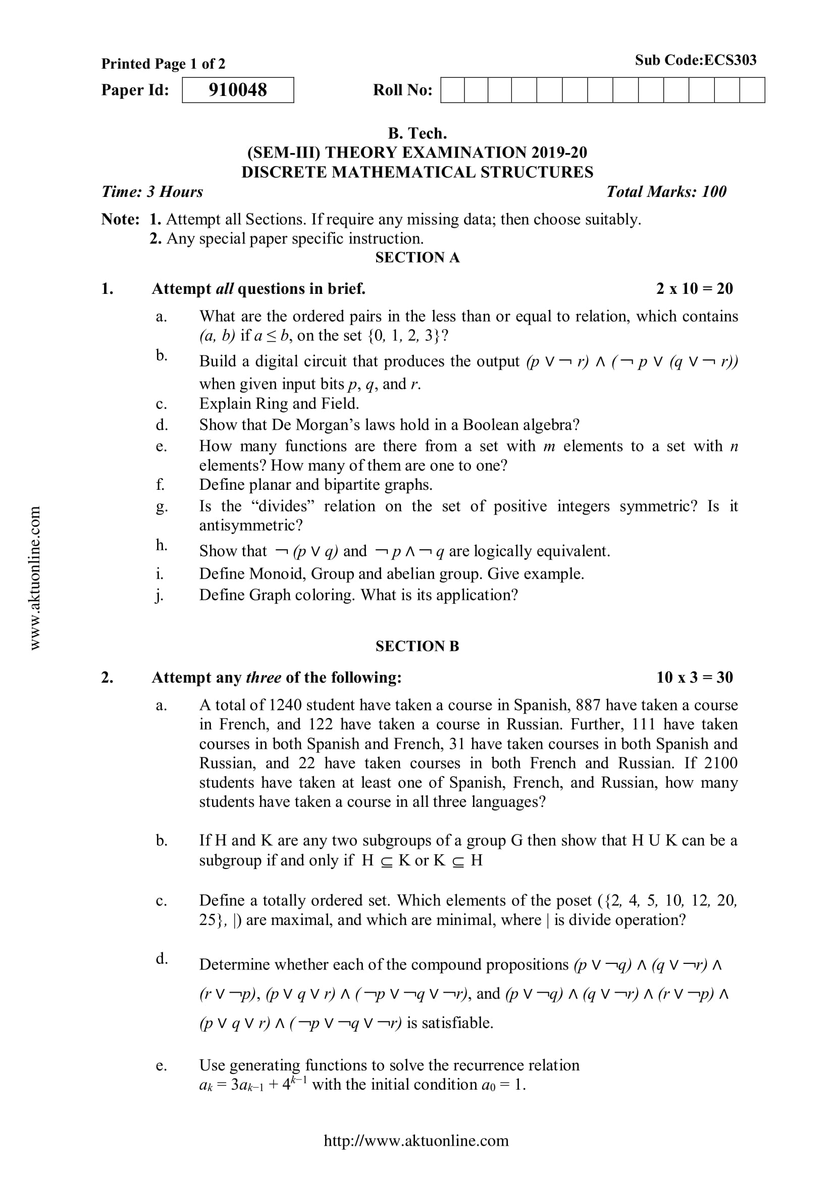
Old Question Papers (CO4)
Mr. Gaurav Singhania, Mr. Bhupendra Kr. KCS-303 (DSTL) Unit 4

Slide 52
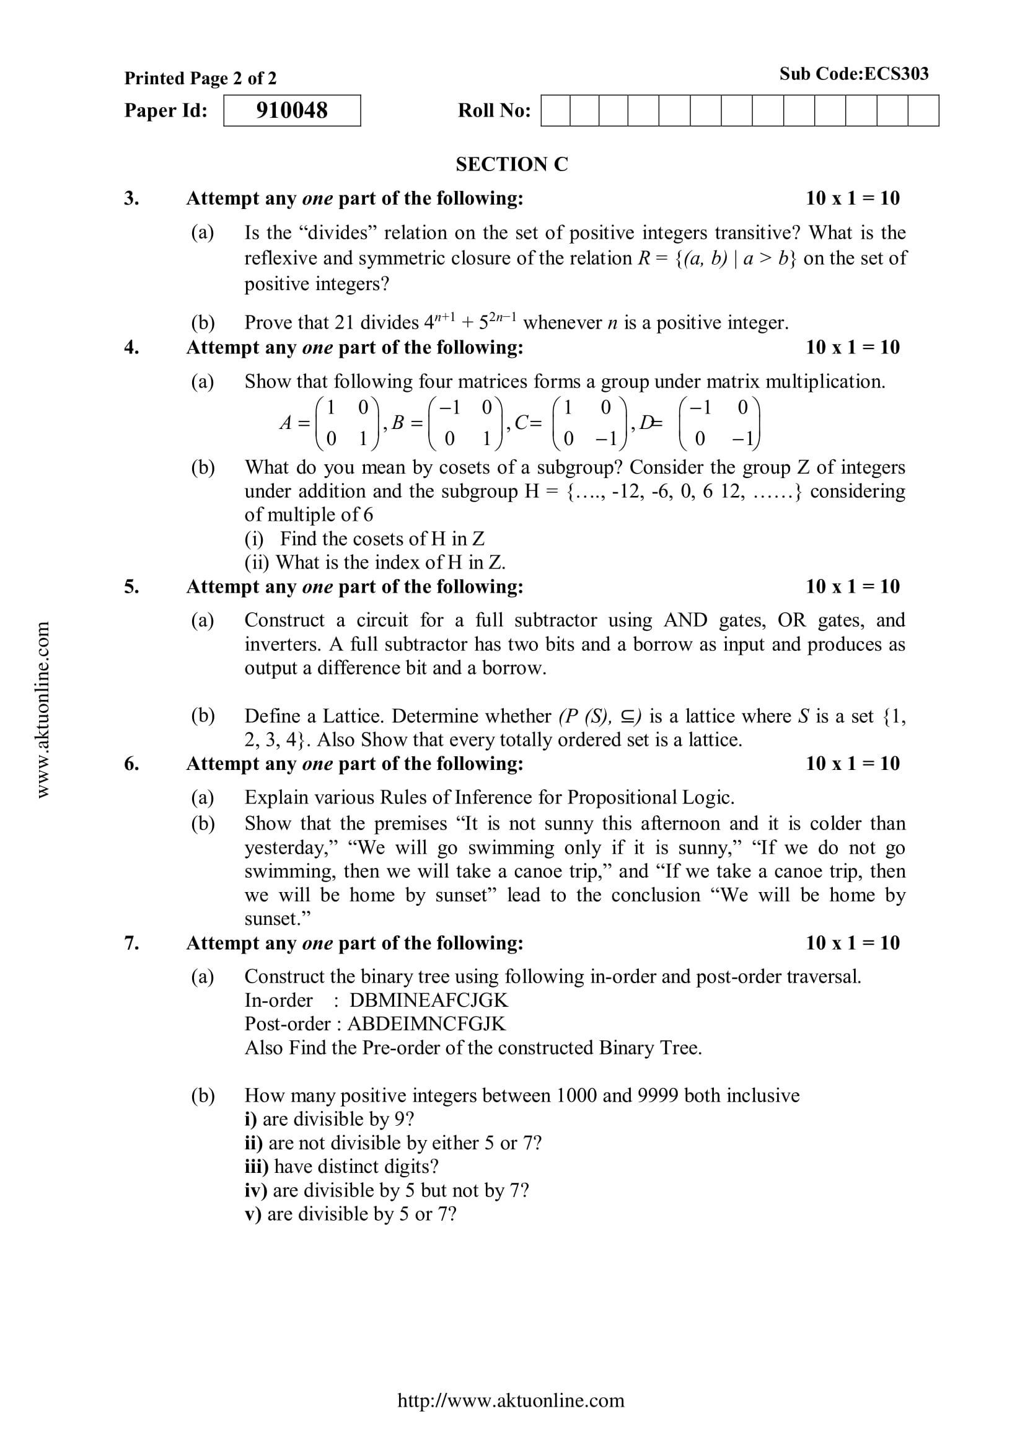
Old Question Papers (CO4)
Mr. Gaurav Singhania, Mr. Bhupendra Kr. KCS-303 (DSTL) Unit 4

Slide 53
Old Question Papers (CO4)
For some more Old Question Papers go to the link below.
https://drive.google.com/drive/folders/1LBqJvyWPNRCdAcr9Sag4TzECfnLgRIQn?usp=sharing
Mr. Gaurav Singhania, Mr. Bhupendra Kr. KCS-303 (DSTL) Unit 4

Slide 54
Expected Questions for University Exam(CO4)
Q1 Construct the truth table for the compound proposition
(𝑝 → 𝑞) ↔ (¬𝑝 → ¬𝑞).
Q2 Write the symbolic representation and give its contra positive statement of “If it rains today, then I buy an umbrella”
Q3 Show that ( 𝑝 → 𝑟) ∧ (𝑞 → 𝑟)𝑎𝑛𝑑 (𝑝 ∨ 𝑞) → 𝑟 are logically equivalent.
Q4 Without using truth table show that 𝑝 → (𝑞 → 𝑝) ⟺ ¬𝑝 → (𝑝 → 𝑞).
Q5 Is ¬𝑝 ∧ (𝑝 ∨ 𝑞)) → 𝑞 a tautology?
Q6 What are the contra positive, the converse and the inverse of the conditional statement “If you work hard then you will be rewarded”.
Mr. Gaurav Singhania, Mr. Bhupendra Kr. KCS-303 (DSTL) Unit 4

Slide 55
Summary (CO4)
Now you were able to understand the concepts discrete structures include sets, relation , functions, Algebraic Structure, poset, lattice, Boolean algebra, predicate logic and prepositional laogic etc.
After understanding propositional logic students will be able to design of computing machines, artificial intelligence, definition of data structures for programming languages etc.
Propositional Logic is concerned with statements to which the truth values, “true” and “false”, can be assigned.
The subject enhances one’s ability to develop logical thinking and ability to problem solving.
Mr. Gaurav Singhania, Mr. Bhupendra Kr. KCS-303 (DSTL) Unit 4

Slide 56
References
B. Kolman, R.C. Busby, and S.C. Ross, Discrete Mathematical Structures, 5/e, Prentice Hall, 2004.
Liptschutz, Seymour, “ Discrete Mathematics”, McGraw Hill.
Trembley, J.P & R. Manohar, “Discrete Mathematical Structure with Application to Computer Science”, McGraw Hill
Koshy, Discrete Structures, Elsevier Pub. 2008 Kenneth H. Rosen, Discrete Mathematics and Its Applications, 6/e, McGraw-Hill, 2006.
Mr. Gaurav Singhania, Mr. Bhupendra Kr. KCS-303 (DSTL) Unit 4

Slide 57

Mr. Gaurav Singhania, Mr. Bhupendra Kr. KCS-303 (DSTL) Unit 4

